Slide 1

EXPLORE TRENDS IN EMISSIONS, POLLUTION, AND HEALTH METRICS ACROSS U.S. STATES WITH DATA ANALYTICS & VISUALIZATION.
Video Link = Click here
Shivansh Bhatnagar (x23237252)
Pratik Sunar (x23292512)
Malav Naik (x23271779)
MSCDAD_A
National College of Ireland, Dublin

Slide 2

Introduction
The intersection of various environmental pollution and public health is a deep area of research, especially the mutual relationship between air pollution, emissions, and cardiovascular health. This comprehensive report analyzes the trends in air pollution from the year 2000 onwards showcases the correlation with emissions from various sectors in different states, and examines the patterns in heart health to show insights into the relationship between pollution levels and cardiovascular diseases. By integrating data analytics and visualization techniques, this study aims to broadcast insights into how Industries and air Pollution target public health, framing strategies and policy decisions to mitigate these risks.

Slide 3


The research seeks to answer the following questions:
What are the trends in air pollution from the 2000s, and how do they correlate with emissions data?
Can patterns in heart health data reveal associations between pollution levels and cardiovascular diseases? Ease of Use.

Slide 4
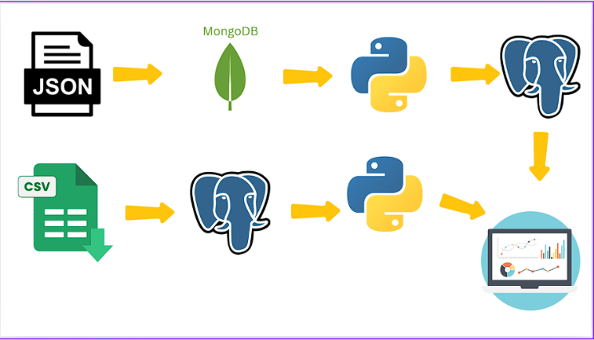
Technology used
MongoDB / PostgreSQL MongoDB was selected for storing the JSON dataset due to its compatibility with the hierarchical structure of the data and its ability to handle unstructured or semi-structured data formats efficiently. The document-oriented nature of MongoDB facilitated flexible data exploration and extraction and To Store Structured Data(CSV) we have used PostgreSQL database.
ETL (Extract Transform Load)
We have used ETL process to commute the data in between different sources. For Extracting semi-structured file(Json) File We have used MongoDB then fetch file to python and store data in PostgreSQL. And for Extracting CSV data we have used PostgreSQL and Load data to SQL.
Extract:- Collected data from MongoDB / SQL to Python.
Transform:- Performed Data Cleaning and Transformed Data.
Load:- Loaded transformed Data, performed further analytics and later stored it to PostgreSQL.

Slide 5
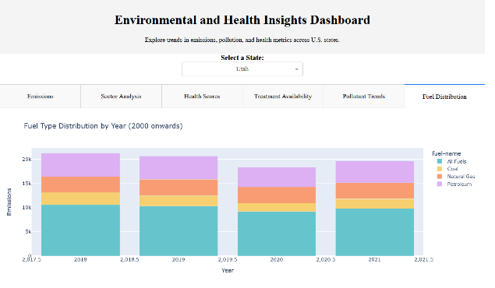
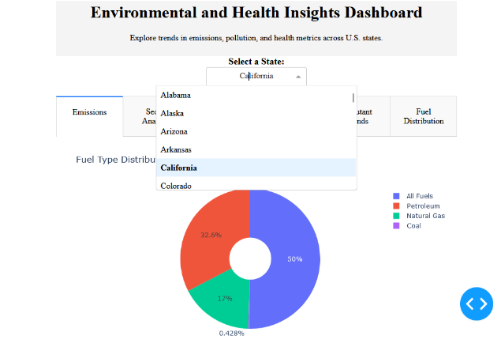
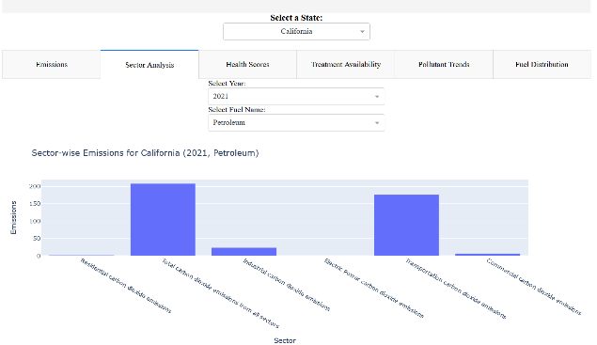
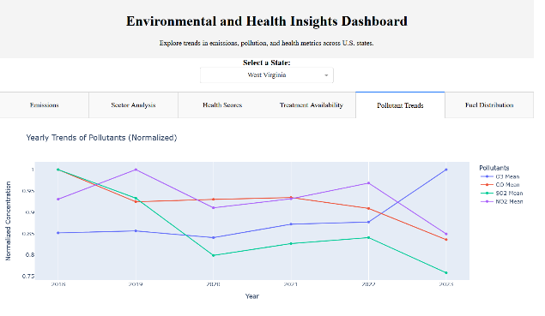
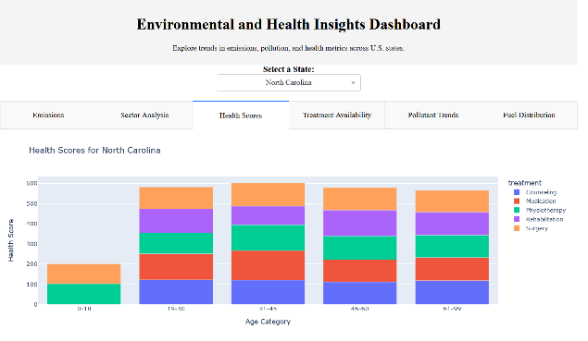
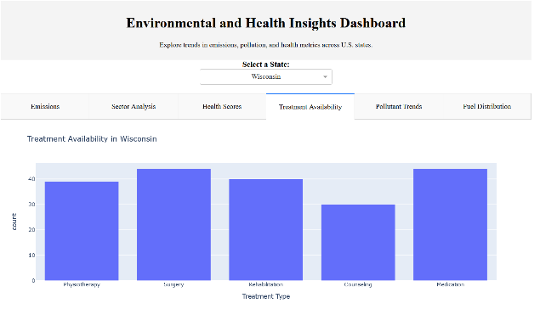
US Environmental and Health Insight Dashboard

